Slide 1

Power BI Dev Case Study Presentation
Tyrone Victor Garcia
Jan 2024

Slide 2

Content
Attrition Dashboard Analysis
Case Study
Steps in Dashboard Creation
Dashboard Samples

Slide 3
Attrition Dashboard

Slide 4
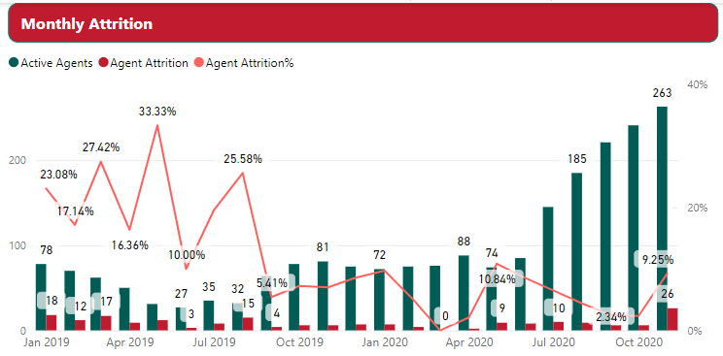
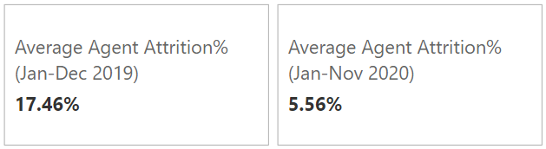
Monthly Attrition
Insights:
There is 325% increase in active agents in Nov 2020 vs Nov 2019.

Slide 5


Monthly Attrition
Insights:
There is 325% increase in active agents in Nov 2020 vs Nov 2019.
Average Attrition% decrease by 11.9%.

Slide 6


Monthly Attrition
Insights:
There is 325% increase in active agents in Nov 2020 vs Nov 2019.
Average Attrition% decrease by 11.9%.
High attrition during May and Oct-Jan.

Slide 7
Monthly Attrition
Insights:
There is 325% increase in active agents in Nov 2020 vs Nov 2019.
Average Attrition% decrease by 11.9%.
High attrition during May and Oct-Jan.

Slide 8
Monthly Attrition
Recommendation:
Company’s effort in lowering attrition to be continued, and find ways improve.
Company should be prepared for seasonal high attrition.

Slide 9
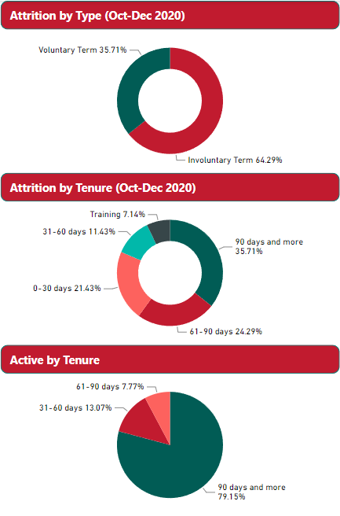
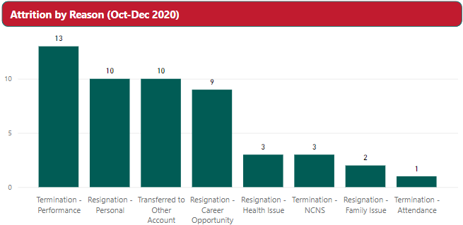
Attrition Data and Active Headcount
About 64.29% of the attrition are involuntary terminated.
Termination due to performance is the most reason of attrition and attendance being the lowest.
Tenured employees (90 days+) accounts 35.71% of total attrition, while training at 7.14% being the lowest.
Active agents consist mostly of tenured.

Slide 10
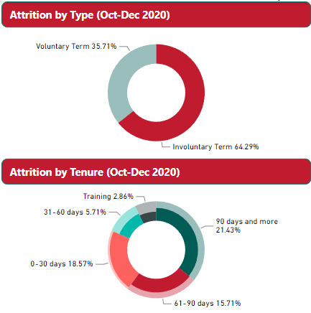
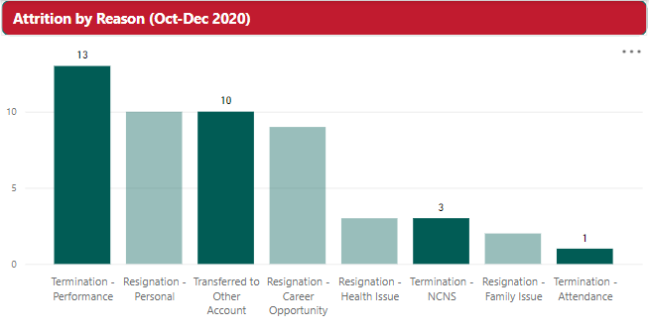
Attrition Analysis (Oct-Dec 2020)
Involuntary Term holds the 1st and the 3rd top reason, which are performance and transferred to other accounts, respectively.
Involuntary term tenured employees accounts for 21.43% of total attrition. Next is 0-30 days that accounts for 18.57% of total attrition, while Training attrition being the lowest at 2.86%.

Slide 11
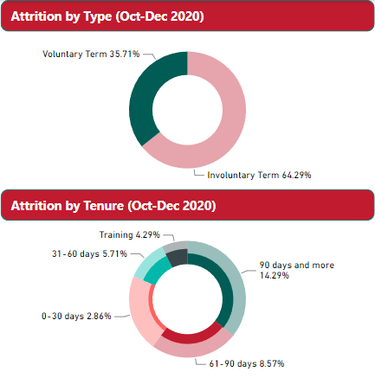
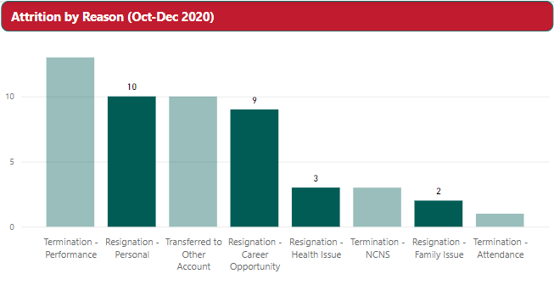
Attrition Analysis (Oct-Dec 2020)
Personal and Career Opportunity are top voluntary term reasons.
Agents 90 days+ also has the highest with 14.29% of total attrition and Training with 4.29%

Slide 12
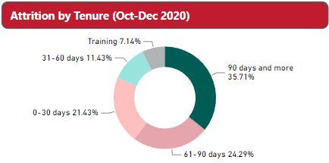
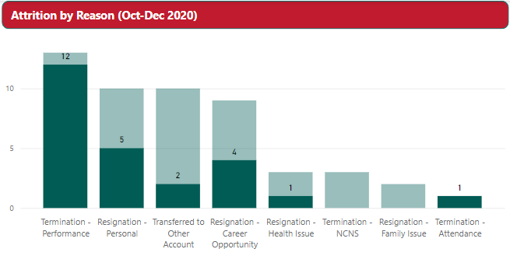
Attrition Analysis (Oct-Dec 2020)
About 92% of Terminated due to Performance are tenured.
While 50% and 44% resigned due to personal and career opportunity, respectively, are coming from tenured.

Slide 13

Recommendation
Focus on tenured agents in terms of their performance and provide more career engagement.
Check if the company is still competitive in terms of salary and benefits.
Provide more performance support even after the agents were endorsed to production.

Slide 14
Case Study

Slide 15
TARGETS | TIME IN SECS | SERVICE LEVEL
VOICE HANDLE TIME | 300 | 93.00%
CHAT RESPONSE TIME | 60 | 95.00%
EMAIL RESPONSE TIME | 1800 | 95.00%
SOCIAL MEDIA RESPONSE TIME | 420 | 95.00%
Case Study
 | MONDAY | TUESDAY | WEDNESDAY | THURSDAY | FRIDAY | SATURDAY | SUNDAY | WEEK AVE
VOICE HANDLE TIME (AVE) | 276 | 286 | 276 | 271 | 277 | 269 | 291 | 278
VOICE SL (%) | 98.82% | 98.79% | 99.42% | 98.76% | 98.38% | 99.69% | 99.18% | 99.01%
CHAT RESPONSE TIME (sec) | 886 | 701 | 721 | 768 | 763 | 706 | 641 | 741
CHAT SL (%) | 97.29% | 98.81% | 98.89% | 97.15% | 99.04% | 99.14% | 100.00% | 98.62%
EMAIL RESPONSE TIME (sec) | 578 | 560 | 522 | 561 | 522 | 486 | 500 | 533
EMAIL SL (%) | 98.84% | 99.22% | 98.73% | 99.31% | 98.58% | 99.20% | 98.95% | 98.98%
SOCIAL MEDIA RESPONSE TIME (sec) | 80 | 90 | 82 | 79 | 63 | 115 | 148 | 94
SOCIAL MEDIA SL (%) | 100.00% | 100.00% | 98.06% | 100.00% | 98.98% | 99.30% | 98.45% | 99.26%

Slide 16
TARGETS | TIME IN SECS | SERVICE LEVEL
VOICE HANDLE TIME | 300 | 93.00%
CHAT RESPONSE TIME | 60 | 95.00%
EMAIL RESPONSE TIME | 1800 | 95.00%
SOCIAL MEDIA RESPONSE TIME | 420 | 95.00%
Case Study
 | MONDAY | TUESDAY | WEDNESDAY | THURSDAY | FRIDAY | SATURDAY | SUNDAY | WEEK AVE
VOICE HANDLE TIME (AVE) | 276 | 286 | 276 | 271 | 277 | 269 | 291 | 278
VOICE SL (%) | 98.82% | 98.79% | 99.42% | 98.76% | 98.38% | 99.69% | 99.18% | 99.01%
CHAT RESPONSE TIME (sec) | 886 | 701 | 721 | 768 | 763 | 706 | 641 | 741
CHAT SL (%) | 97.29% | 98.81% | 98.89% | 97.15% | 99.04% | 99.14% | 100.00% | 98.62%
EMAIL RESPONSE TIME (sec) | 578 | 560 | 522 | 561 | 522 | 486 | 500 | 533
EMAIL SL (%) | 98.84% | 99.22% | 98.73% | 99.31% | 98.58% | 99.20% | 98.95% | 98.98%
SOCIAL MEDIA RESPONSE TIME (sec) | 80 | 90 | 82 | 79 | 63 | 115 | 148 | 94
SOCIAL MEDIA SL (%) | 100.00% | 100.00% | 98.06% | 100.00% | 98.98% | 99.30% | 98.45% | 99.26%
All targets are met except for average Chat Response Time which is 1,235% higher than the target.

Slide 17
TARGETS | TIME IN SECS | SERVICE LEVEL
VOICE HANDLE TIME | 300 | 93.00%
CHAT RESPONSE TIME | 60 | 95.00%
EMAIL RESPONSE TIME | 1800 | 95.00%
SOCIAL MEDIA RESPONSE TIME | 420 | 95.00%
Case Study
 | MONDAY | TUESDAY | WEDNESDAY | THURSDAY | FRIDAY | SATURDAY | SUNDAY | WEEK AVE
VOICE HANDLE TIME (AVE) | 276 | 286 | 276 | 271 | 277 | 269 | 291 | 278
VOICE SL (%) | 98.82% | 98.79% | 99.42% | 98.76% | 98.38% | 99.69% | 99.18% | 99.01%
CHAT RESPONSE TIME (sec) | 886 | 701 | 721 | 768 | 763 | 706 | 641 | 741
CHAT SL (%) | 97.29% | 98.81% | 98.89% | 97.15% | 99.04% | 99.14% | 100.00% | 98.62%
EMAIL RESPONSE TIME (sec) | 578 | 560 | 522 | 561 | 522 | 486 | 500 | 533
EMAIL SL (%) | 98.84% | 99.22% | 98.73% | 99.31% | 98.58% | 99.20% | 98.95% | 98.98%
SOCIAL MEDIA RESPONSE TIME (sec) | 80 | 90 | 82 | 79 | 63 | 115 | 148 | 94
SOCIAL MEDIA SL (%) | 100.00% | 100.00% | 98.06% | 100.00% | 98.98% | 99.30% | 98.45% | 99.26%
All targets are met except for average Chat Response Time which is 1,235% higher than the target.
There are days with dip in Service Level.

Slide 18
TARGETS | TIME IN SECS | SERVICE LEVEL
VOICE HANDLE TIME | 300 | 93.00%
CHAT RESPONSE TIME | 60 | 95.00%
EMAIL RESPONSE TIME | 1800 | 95.00%
SOCIAL MEDIA RESPONSE TIME | 420 | 95.00%
Case Study
 | MONDAY | TUESDAY | WEDNESDAY | THURSDAY | FRIDAY | SATURDAY | SUNDAY | WEEK AVE
VOICE HANDLE TIME (AVE) | 276 | 286 | 276 | 271 | 277 | 269 | 291 | 278
VOICE SL (%) | 98.82% | 98.79% | 99.42% | 98.76% | 98.38% | 99.69% | 99.18% | 99.01%
CHAT RESPONSE TIME (sec) | 886 | 701 | 721 | 768 | 763 | 706 | 641 | 741
CHAT SL (%) | 97.29% | 98.81% | 98.89% | 97.15% | 99.04% | 99.14% | 100.00% | 98.62%
EMAIL RESPONSE TIME (sec) | 578 | 560 | 522 | 561 | 522 | 486 | 500 | 533
EMAIL SL (%) | 98.84% | 99.22% | 98.73% | 99.31% | 98.58% | 99.20% | 98.95% | 98.98%
SOCIAL MEDIA RESPONSE TIME (sec) | 80 | 90 | 82 | 79 | 63 | 115 | 148 | 94
SOCIAL MEDIA SL (%) | 100.00% | 100.00% | 98.06% | 100.00% | 98.98% | 99.30% | 98.45% | 99.26%
All targets are met except for average Chat Response Time which is 1,235% higher than the target.
There are days with dip in Service Level.

Slide 19
TARGETS | TIME IN SECS | SERVICE LEVEL
VOICE HANDLE TIME | 300 | 93.00%
CHAT RESPONSE TIME | 60 | 95.00%
EMAIL RESPONSE TIME | 1800 | 95.00%
SOCIAL MEDIA RESPONSE TIME | 420 | 95.00%
Case Study
 | MONDAY | TUESDAY | WEDNESDAY | THURSDAY | FRIDAY | SATURDAY | SUNDAY | WEEK AVE
VOICE HANDLE TIME (AVE) | 276 | 286 | 276 | 271 | 277 | 269 | 291 | 278
VOICE SL (%) | 98.82% | 98.79% | 99.42% | 98.76% | 98.38% | 99.69% | 99.18% | 99.01%
CHAT RESPONSE TIME (sec) | 886 | 701 | 721 | 768 | 763 | 706 | 641 | 741
CHAT SL (%) | 97.29% | 98.81% | 98.89% | 97.15% | 99.04% | 99.14% | 100.00% | 98.62%
EMAIL RESPONSE TIME (sec) | 578 | 560 | 522 | 561 | 522 | 486 | 500 | 533
EMAIL SL (%) | 98.84% | 99.22% | 98.73% | 99.31% | 98.58% | 99.20% | 98.95% | 98.98%
SOCIAL MEDIA RESPONSE TIME (sec) | 80 | 90 | 82 | 79 | 63 | 115 | 148 | 94
SOCIAL MEDIA SL (%) | 100.00% | 100.00% | 98.06% | 100.00% | 98.98% | 99.30% | 98.45% | 99.26%
All targets are met except for average Chat Response Time which is 1,235% higher than the target.
There are days with dip in Service Level.

Slide 20
TARGETS | TIME IN SECS | SERVICE LEVEL
VOICE HANDLE TIME | 300 | 93.00%
CHAT RESPONSE TIME | 60 | 95.00%
EMAIL RESPONSE TIME | 1800 | 95.00%
SOCIAL MEDIA RESPONSE TIME | 420 | 95.00%
Case Study
 | MONDAY | TUESDAY | WEDNESDAY | THURSDAY | FRIDAY | SATURDAY | SUNDAY | WEEK AVE
VOICE HANDLE TIME (AVE) | 276 | 286 | 276 | 271 | 277 | 269 | 291 | 278
VOICE SL (%) | 98.82% | 98.79% | 99.42% | 98.76% | 98.38% | 99.69% | 99.18% | 99.01%
CHAT RESPONSE TIME (sec) | 886 | 701 | 721 | 768 | 763 | 706 | 641 | 741
CHAT SL (%) | 97.29% | 98.81% | 98.89% | 97.15% | 99.04% | 99.14% | 100.00% | 98.62%
EMAIL RESPONSE TIME (sec) | 578 | 560 | 522 | 561 | 522 | 486 | 500 | 533
EMAIL SL (%) | 98.84% | 99.22% | 98.73% | 99.31% | 98.58% | 99.20% | 98.95% | 98.98%
SOCIAL MEDIA RESPONSE TIME (sec) | 80 | 90 | 82 | 79 | 63 | 115 | 148 | 94
SOCIAL MEDIA SL (%) | 100.00% | 100.00% | 98.06% | 100.00% | 98.98% | 99.30% | 98.45% | 99.26%
All targets are met except for average Chat Response Time which is 1,235% higher than the target.
There are days with dip in Service Level.

Slide 21
TARGETS | TIME IN SECS | SERVICE LEVEL
VOICE HANDLE TIME | 300 | 93.00%
CHAT RESPONSE TIME | 60 | 95.00%
EMAIL RESPONSE TIME | 1800 | 95.00%
SOCIAL MEDIA RESPONSE TIME | 420 | 95.00%
Case Study
 | MONDAY | TUESDAY | WEDNESDAY | THURSDAY | FRIDAY | SATURDAY | SUNDAY | WEEK AVE
VOICE HANDLE TIME (AVE) | 276 | 286 | 276 | 271 | 277 | 269 | 291 | 278
VOICE SL (%) | 98.82% | 98.79% | 99.42% | 98.76% | 98.38% | 99.69% | 99.18% | 99.01%
CHAT RESPONSE TIME (sec) | 886 | 701 | 721 | 768 | 763 | 706 | 641 | 741
CHAT SL (%) | 97.29% | 98.81% | 98.89% | 97.15% | 99.04% | 99.14% | 100.00% | 98.62%
EMAIL RESPONSE TIME (sec) | 578 | 560 | 522 | 561 | 522 | 486 | 500 | 533
EMAIL SL (%) | 98.84% | 99.22% | 98.73% | 99.31% | 98.58% | 99.20% | 98.95% | 98.98%
SOCIAL MEDIA RESPONSE TIME (sec) | 80 | 90 | 82 | 79 | 63 | 115 | 148 | 94
SOCIAL MEDIA SL (%) | 100.00% | 100.00% | 98.06% | 100.00% | 98.98% | 99.30% | 98.45% | 99.26%
All targets are met except for average Chat Response Time which is 1,235% higher than the target.
There are days with dip in Service Level.

Slide 27

Recommendations
All accounts:
Consistently monitor and find ways to improve more.
Investigate the days where Service Level is low. Check if it’s temporary or recurring issue
Chat:
Identify the bottlenecks or inefficiency that results to longer response time.
Social Media:
Focus on improving during weekends when most of the people are using social media.

Slide 28
What metrics need to be gathered?
Volumes per Day
Agent Availability
Average Handling Time
Customer Satisfaction Score
First Contact Resolution Rate

Slide 29
Steps in Dashboard Creation

Slide 30

Steps when creating a new dashboard
Identify Business Problem.
Know stakeholders and how they will use the dashboard.
List metrics and graphs needed.
Identify people you will be needing their help for this project.
Set timeline and draft dashboard mockup.
Dashboard creation.

Slide 31
Dashboard Samples

Slide 32
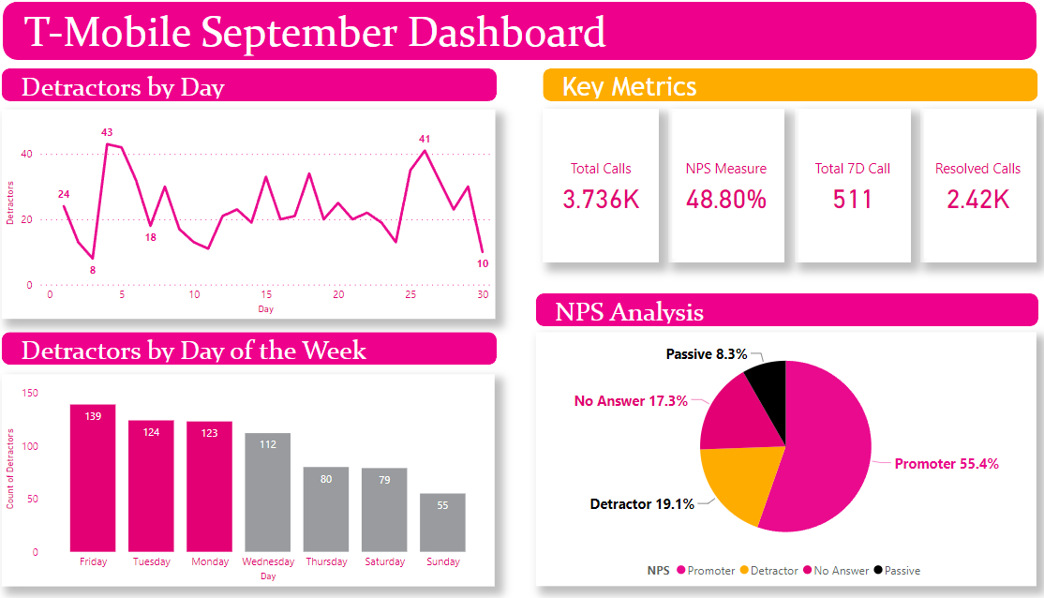

Slide 33
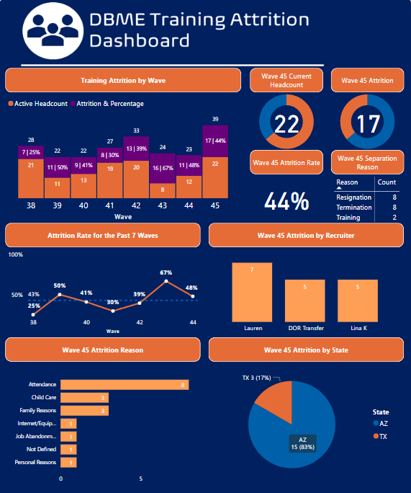

Slide 34
-End of Presentation- Thank you!

